Slide 1
<title>Race in Colorado</title>
Martin Jimenez
Data from the Decennial (2020) U.S. Census Bureau

Slide 2
<h1>What questions can be answered from the data?</h1>
What is the most populated race?
What is the least populated race?
What is the most populated diverse group? (Population identifying as two or more races.)
What is this data set missing and how can it be improved?

Slide 3
What the MAX(B:4,B:9) and MIN (B:4, B:9) Tells Us
Column B provides us with the quantity of people that reside in Colorado. More specifically, from rows (B:4,B:9) we see the population that identifies as only one race.
Based on the data provided by the U.S. Census Bureau, the total population in Colorado was 5,773,714. The amount of people that identified with one race was 5,066,044,. Meaning the rest of the population identifying with two or more races was 707,670. The most populated race in 2020 were “whites alone” with a total of 4,082,927 people.
The lowest (single raced) population were Native Hawaiian and Other Pacific Islanders alone, which consisted of 10,287 people.

Slide 4
The most diverse group
This data set provides information for people that identify for up to six different races. Now I am not sure exactly how that works, but based on the data, those numbers get lower as diversity increases.
The total population of people that identify as: White; Black or African American; American Indian and Alaska Native; Asian; Native Hawaiian and Other Pacific Islander; Some Other Race was 48.
The race with the lowest total population, were those that identified as: Black or African American; Asian; Native Hawaiian and Other Pacific Islander; Some Other Race. Which was a total of only 2 people.

Slide 5
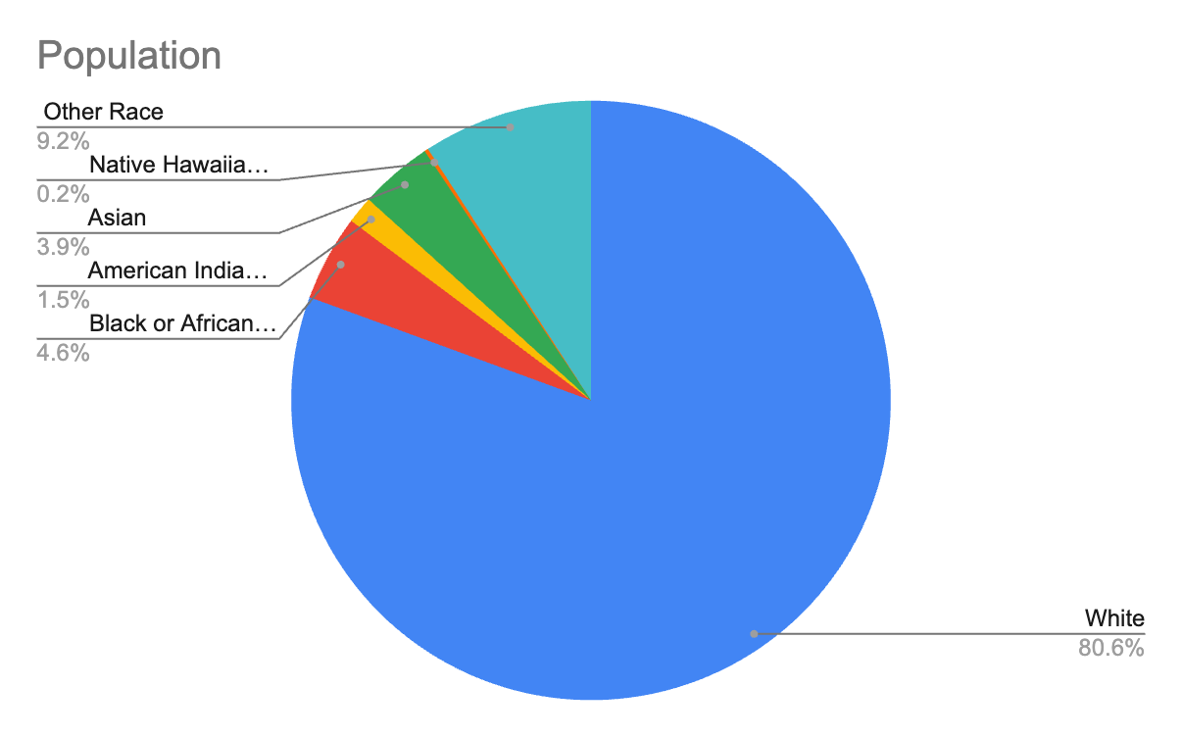
How does it look on a graph?
Based on the information of the population that only identifies with one race, the white population accounts for 80.6%. The second largest value is the 9.2% of the population that identifies as “other race.”

Slide 6
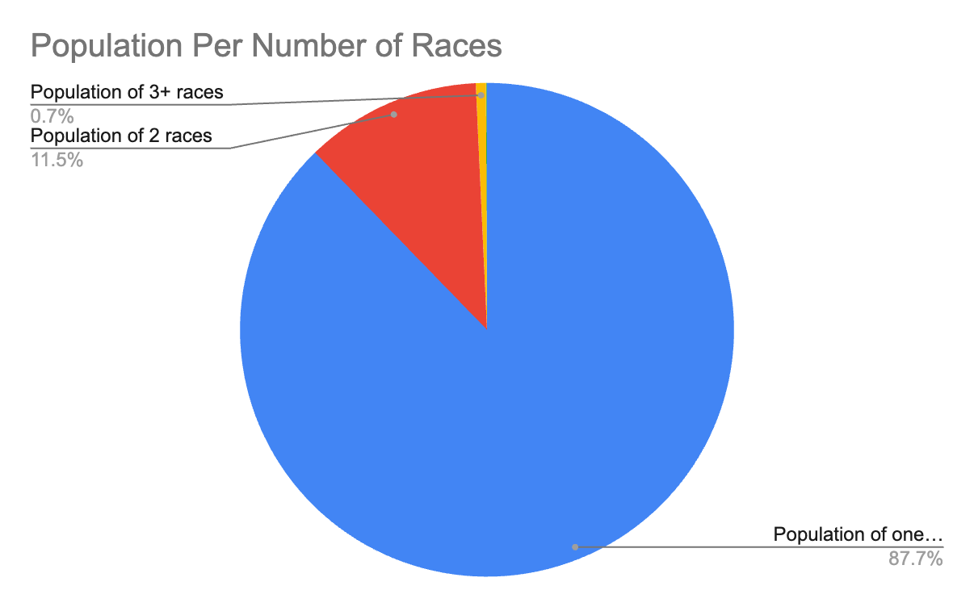
Graphs Continued
By taking a look at this graph, it is difficult to scale the population that identifies with more than 3 races because of the portion of the population that identifies as only one race. We are comparing numbers like 5,066,044 to 423 and 48.

Slide 7
Problems with the data
Throughout my research, I realized that not all data sets are constructed very well. I ran into issues with some other data sets that I was trying to work with but quickly realized that the data was all over the place and I was not experienced enough to find the needle in the haystack. This is probably why I did so poorly on the “Big Data” module in the Khan Academy.
This data set that I chose to work with also imposed a bias and lacked certain information. The data grouped people that didn’t identify as any of the available races as “some other race alone”. In that group, there was a total of 464,046 people. This means that within that population, there could have been several other races that people identified as that could have made our data set more diverse.

Slide 8
Link to CSV data set used
U.S. Census Bureau:
https://data.census.gov/table/DECENNIALPL2020.P1?q=Colorado

